Slide 1



DS_DataSpark: Illuminating Insights for Global Electronics
Presented by Srigurubalaji R

Slide 2
Abstract
By analysing Global Electronics' customer, product, sales, and store data, we aim to identify key insights that will enhance marketing strategies, optimize inventory management, and improve sales forecasting.

Slide 3
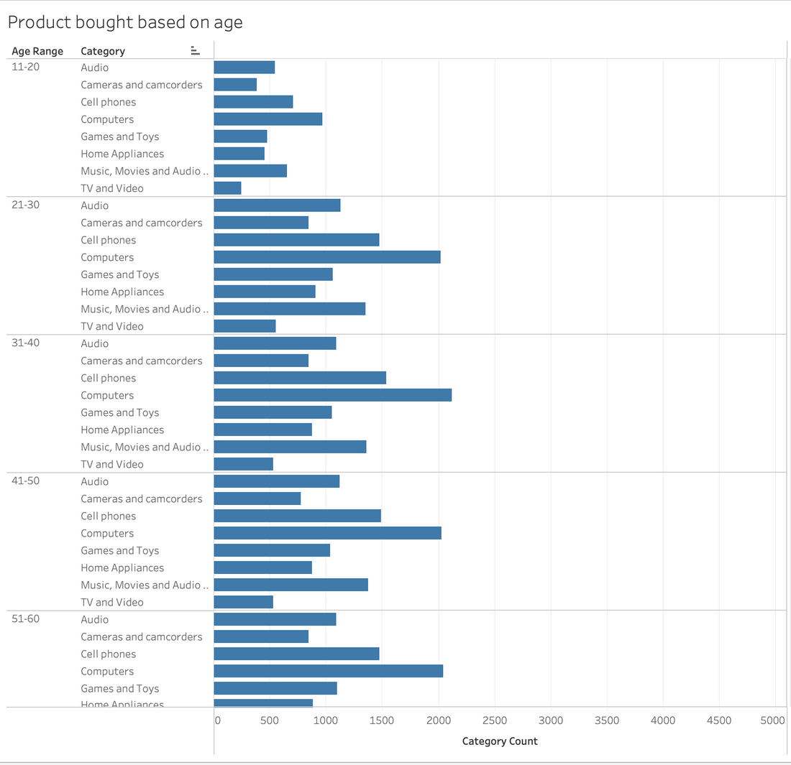
Product Based on Age:
By visualising the given data, we can conclude that people of different ages have their own interests when it comes to buying the product. However, we can also conclude that computers have sold the most across all age categories.

Slide 4
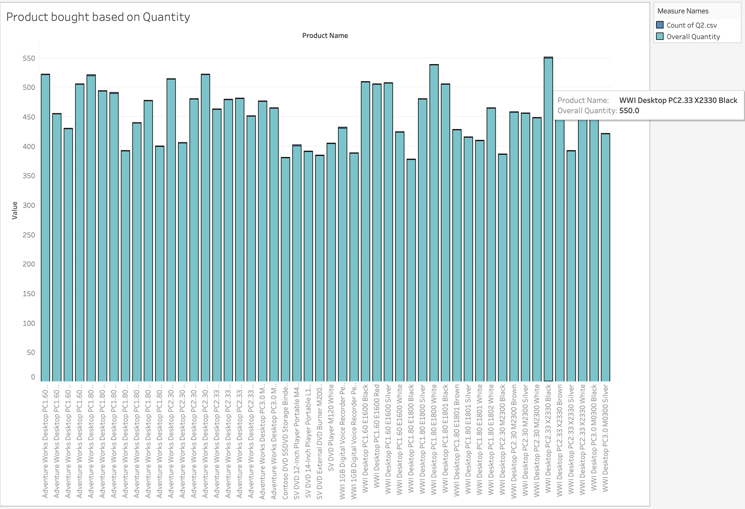
Based on Quantity:
Based on the analysis of product purchases, it can be concluded that the WWI Desktop PC.33.X32330 has the highest market share in terms of margin.

Slide 5
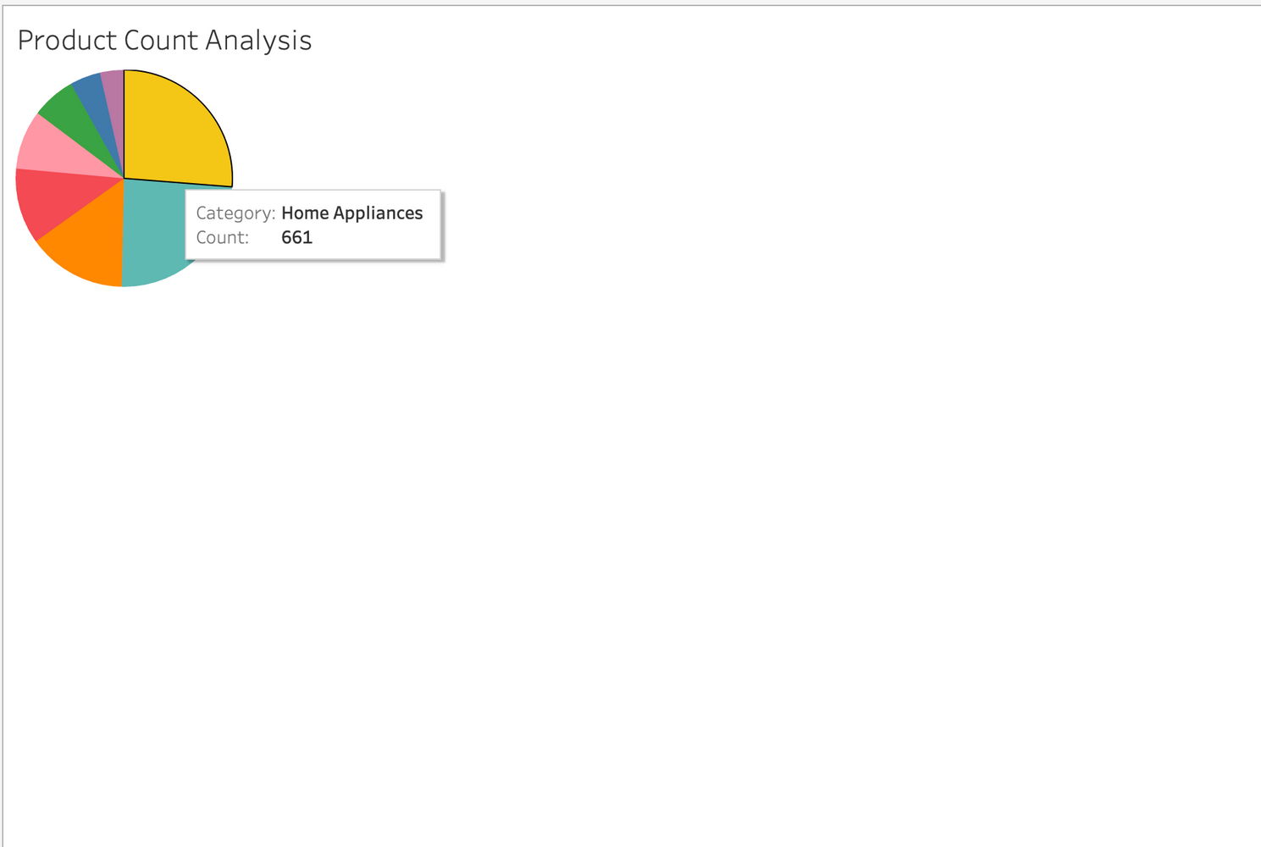
Based on Category:
Based on the analysis of sales data across various product categories, it is evident that home appliances have emerged as the top-selling category. This trend highlights the significant consumer demand for products that enhance daily living and convenience in household tasks.

Slide 6
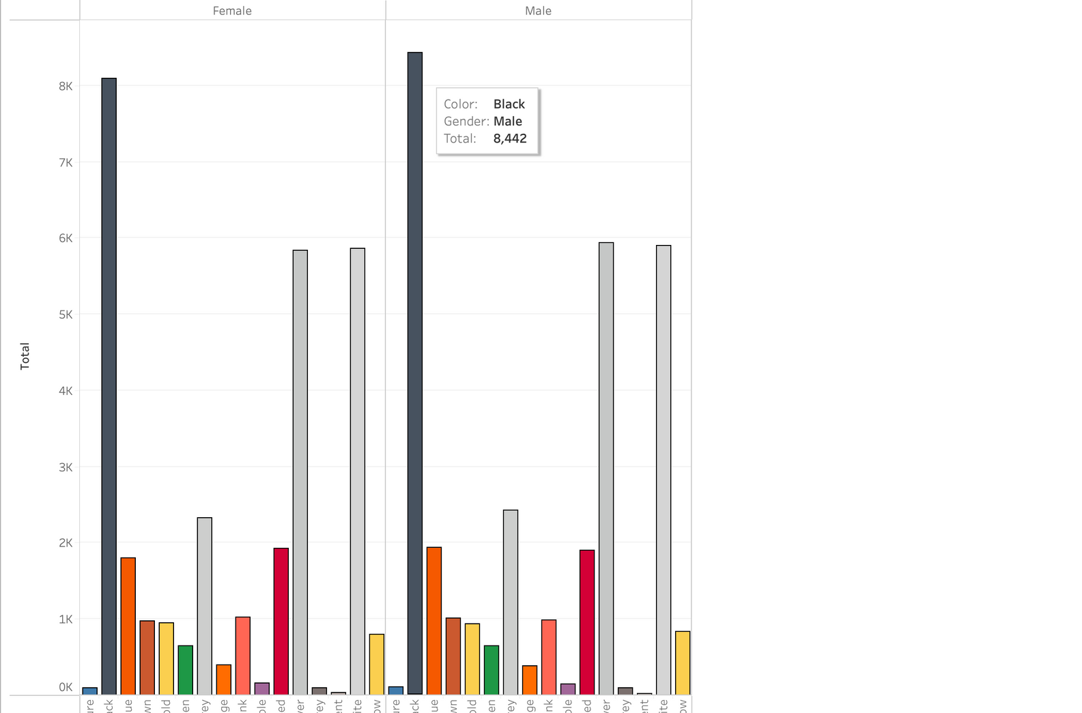
Based on Colour:
According to the sales data analysed, black appears to be the most preferred color choice among both male and female consumers across various product categories. This trend suggests that black is a versatile and popular color option that appeals to a wide range of customers, regardless of their gender.

Slide 7
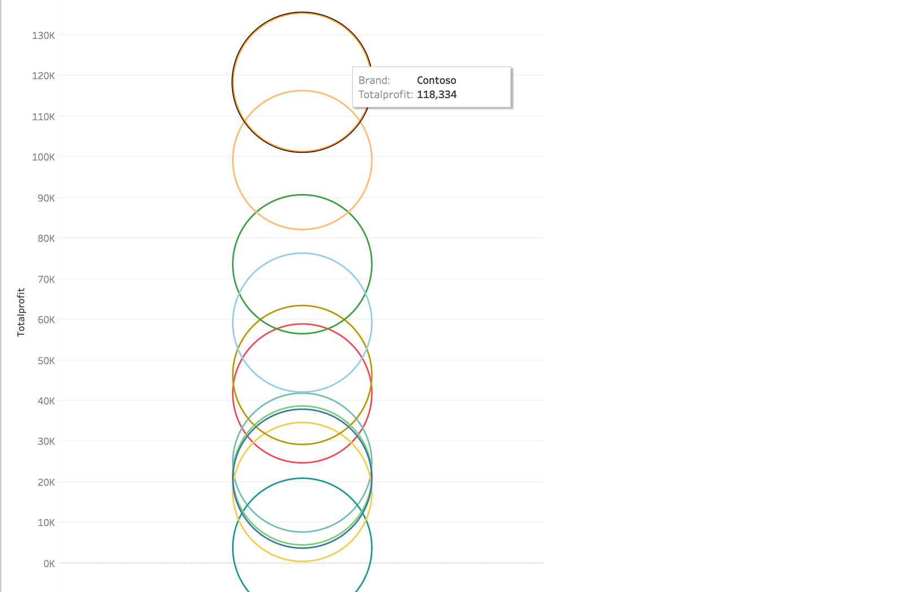
Based on Brand:
X Company has the highest profit margin compared to all other companies in the industry. This indicates a strong financial performance and effective cost management, positioning X Company as a leader in profitability.

Slide 8
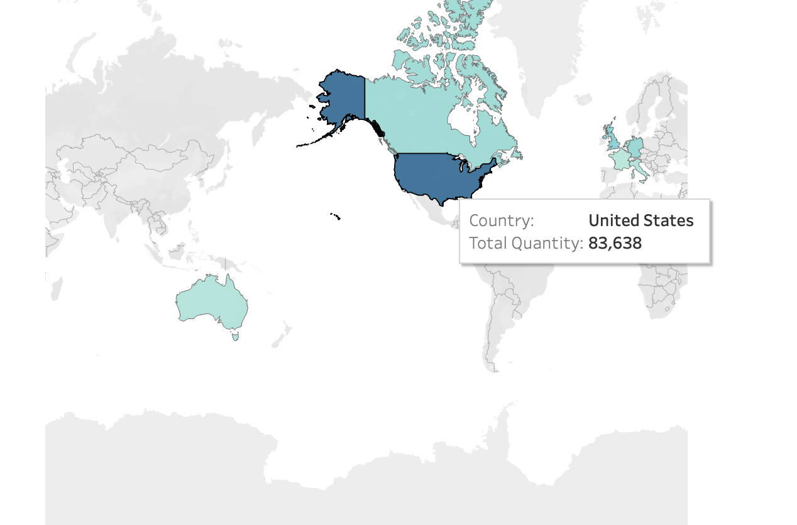
Based on Location:
Based on the analysis of sales data, the United States has a significantly higher sales margin compared to all other countries. This trend highlights the robust consumer demand and favorable market conditions present in the U.S. market.

Slide 9
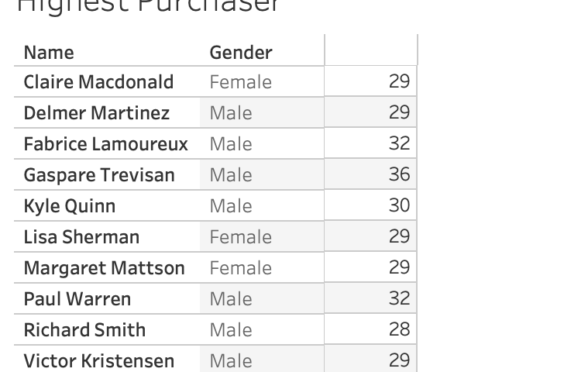
Based on Individuals:
Based on the analysis of sales data, there are many repeat customers, indicating a strong level of customer loyalty. This data can be leveraged to enhance customer trust and engagement by implementing targeted marketing strategies, personalised communication, and loyalty programs.

Slide 10
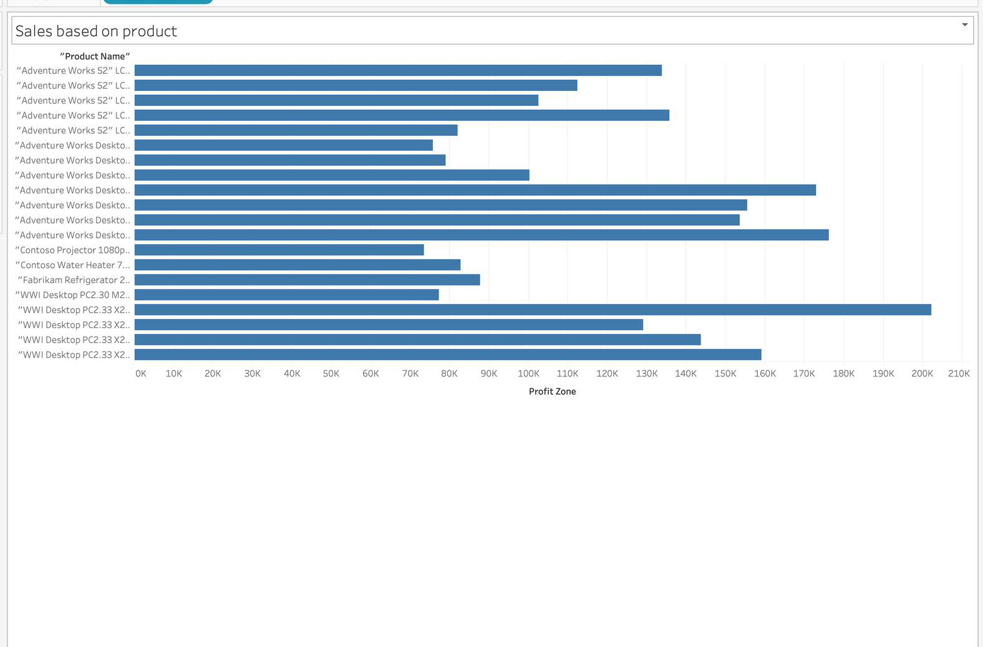
Based on Product:
Based on the analysis of sales data, the following products have demonstrated significant market value and strong sales performance. By further promoting these high-value products, we can capitalize on their popularity and potentially increase overall sales.

Slide 11
Thank
You
Presented by SRIGURUBALAJI R

